Slide 1
Data profiling and data quality dimensions
By maz

Slide 2

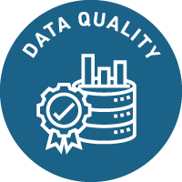
Introduction
When preparing data for analysis, data quality is a crucial component. Results that are erroneous due to poor data quality might have detrimental effects on decision-making. As a result, when gathering data for analysis, data quality must be taken into consideration. The significance of data quality and how to take it into consideration when getting ready data for analysis will be covered in this presentation. It will go over subjects like data profiling, handling errors, and the various aspects of data quality.

Slide 3
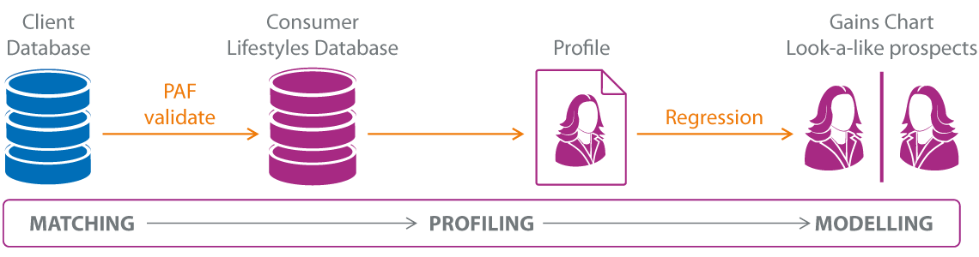
Data Profiling
Data profiling is the process of analysing a dataset to find trends and traits that can be utilised to increase its precision, usefulness, and quality. It entails examining both the dataset's content and its structure (such as the number of columns and rows) (e.g., values in each column). Before a dataset can be used for analysis, mistakes or other problems need to be fixed, and data profiling can help with this. For instance, these problems must be resolved before a dataset may be used for analysis if it has missing or inaccurate values.

Slide 4

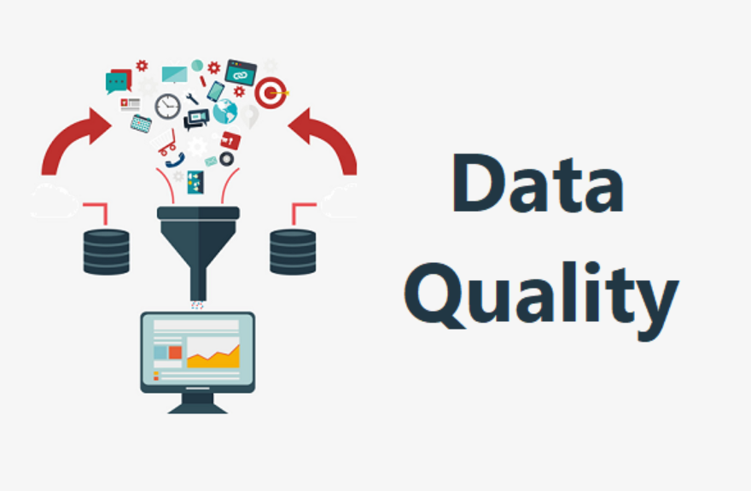
Data quality
Any organisation must consider the importance of data quality. The organisation is in charge of making sure that the data is accurate, complete, and up to date. Poor data quality might result in erroneous analyses and judgments that could harm the organization's success. In order to ensure that the results of the analysis are accurate and relevant, it is crucial to consider data quality when preparing the data for analysis.

Slide 5
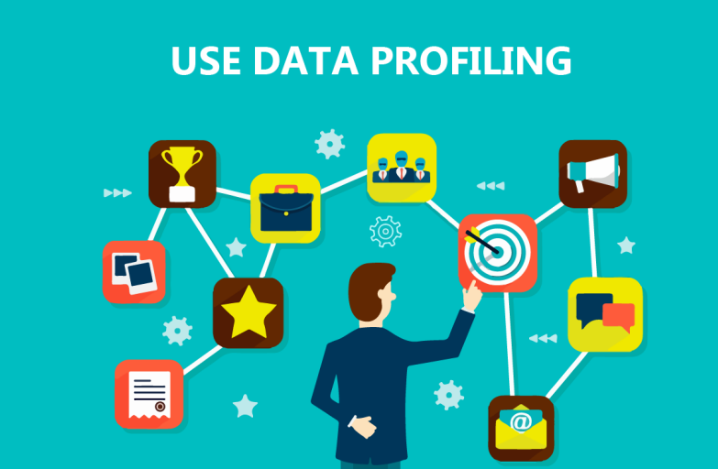
Data profiling
A crucial step in getting data ready for analysis is data profiling. The process of acquiring, studying, and compiling metadata on the data structures and pieces inside a dataset is known as data profiling. It is employed to convey knowledge of the organisation and application of the data. By spotting patterns, trends, outliers, and anomalies that can point to data problems, data profiling can offer insightful information about the quality of the data.

Slide 6
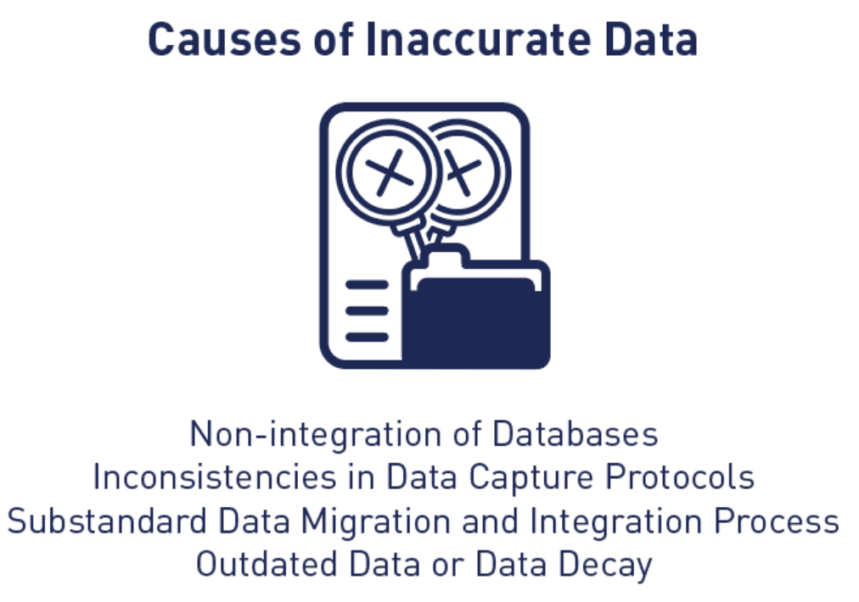
Inaccurate data results
It's crucial to find and fix any problems with data quality while getting ready data for analysis. Errors and concerns with data quality can both be categorised. Data mistakes or inaccuracies are referred to as errors because they can produce inaccurate findings. The accuracy, completeness, or use of the results may be impacted by issues with the data. There are various alternatives for fixing a problem or defect once it is discovered.

Slide 7
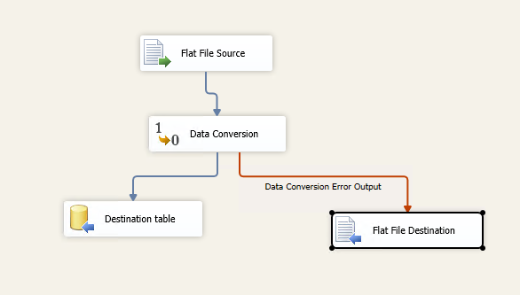
Error Handling
In order to secure reliable results from the analysis, it is necessary to handle any errors or issues that are discovered during data profiling. Accept, Reject, Correct Error, and Create Default Value are the most often used error handling techniques.

Slide 8

Accept
This approach entails accepting the mistake without making any modifications or repairs. This is typically done when the inaccuracy has little bearing on the accuracy or value of the analysis's findings.

Slide 9

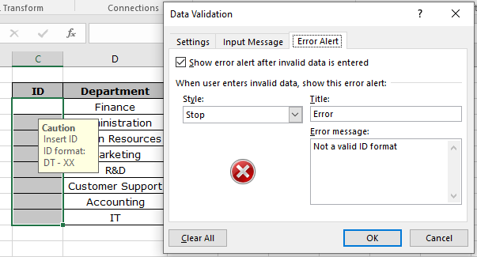
Reject
This approach entails removing any records that contain mistakes from the dataset before conducting any analysis. This is typically done when a dataset contains too many errors that are difficult to rectify or when it is impossible to establish what value should be used in place of an error in a record.

Slide 10

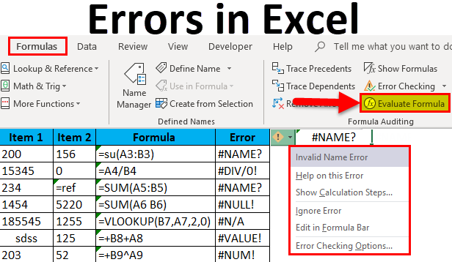
Correct Error
This approach entails fixing any mistakes in a dataset before running any analyses on it. This is typically done when a dataset only has a small number of inaccuracies that can be quickly fixed by swapping out wrong values for correct ones or by filling in blanks with pertinent data.

Slide 11
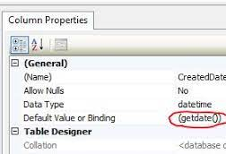
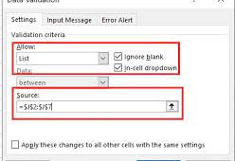
Create Default Value
With this approach, records with errors are given default values before any analysis is done on them. This is typically done when a dataset has too many errors that are difficult to rectify or when it is impossible to establish what value should replace an incorrect one in a record but some sort of value still needs to be present (e.g., 0).

Slide 12
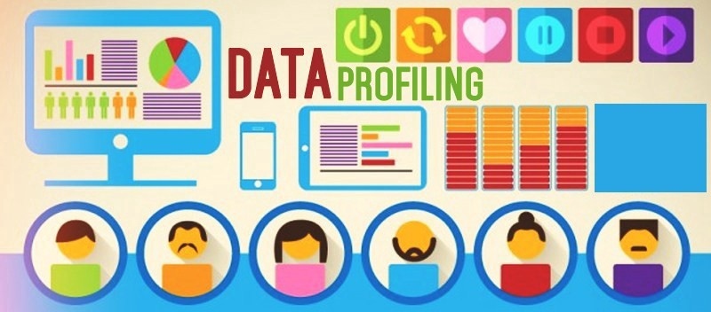
Introduction
When preparing data for analysis, data quality is a crucial component. Results that are erroneous due to poor data quality might have detrimental effects on decision-making. As a result, when gathering data for analysis, data quality must be taken into consideration. The significance of data quality and how to take it into consideration when getting ready data for analysis will be covered in this. Data profiling and the many facets of data quality will be the two key areas of emphasis.

Slide 13
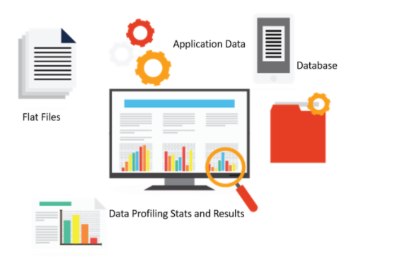
Data Profiling
Data profiling is a method for evaluating a dataset's quality by looking at its fields' relationships, structure, and content. It entails examining the dataset to find trends, patterns, outliers, and other traits that could influence the precision and applicability of the conclusions drawn from the analysis. Data profiling can assist in spotting potential dataset issues before they arise during analysis. For instance, it can identify missing or erroneous values that, if fixed before analysis, could produce false results. Additionally, it can aid in the discovery of correlations between fields that might be helpful in improving our comprehension of the information or in the creation of more precise models.

Slide 14
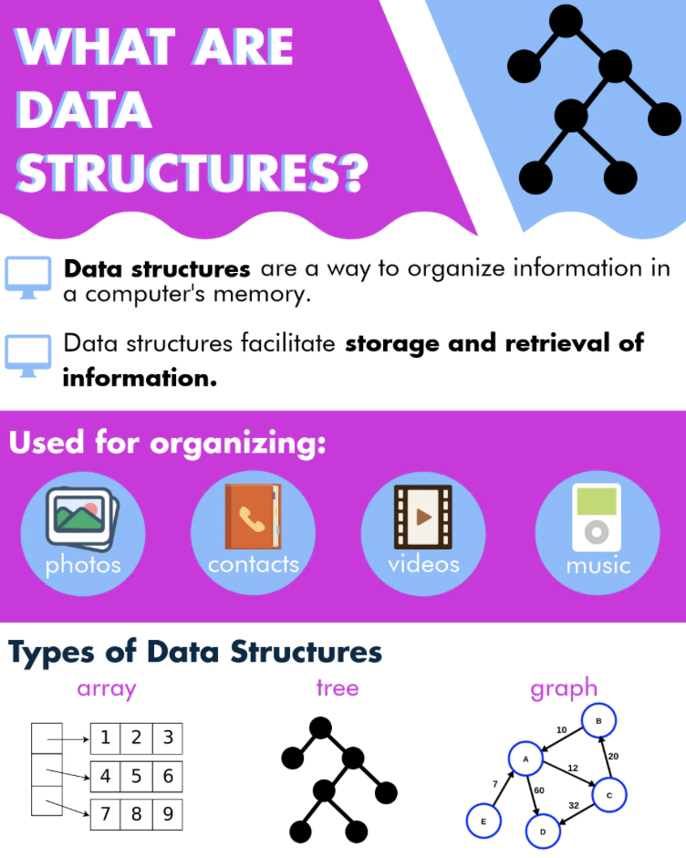
Data structure
The structure of the dataset must be examined as the initial step in data profiling. For each field, this entails examining its names, kinds (such as text or numeric), lengths (such as the maximum length for a text field), and any other pertinent details, such as whether it is necessary or optional. This makes sure that, before analysis begins, all fields are correctly defined and that any required transformations are carried out.

Slide 15

Data patterns
Examining each field's content in order to spot any patterns or trends is the second step in data profiling. In addition to reviewing individual values inside each field for outliers or other abnormalities that could affect findings if corrected before analysis begins, this involves looking at summary statistics like mean, median, mode, range, standard deviation, etc. Additionally, by identifying associations between fields, this stage might aid in improving comprehension of the dataset or in the creation of more precise models (e.g., correlations between variables).

Slide 16
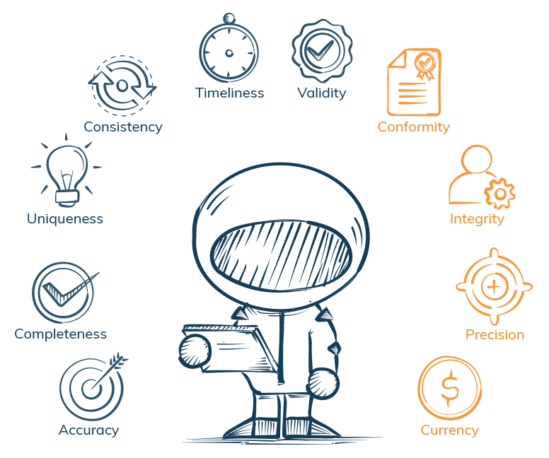
Data validation
Finally, it is crucial to validate the dataset by comparing it to known standards or expectations once all essential transformations have been completed and any potential flaws revealed by data profiling have been resolved (e.g., industry standards). By doing this, it is possible to make sure that before analysis starts, all fields have been appropriately defined and all necessary transformations have been carried out.

Slide 17
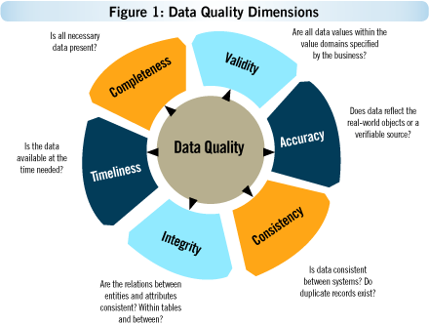
Data Quality Dimensions
Data completeness, uniqueness, timeliness, validity, accuracy, and consistency are a few of the aspects of data quality that should be taken into account while preparing a dataset for analysis in addition to data profiling.

Slide 18
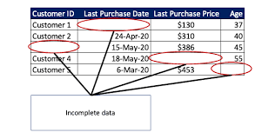
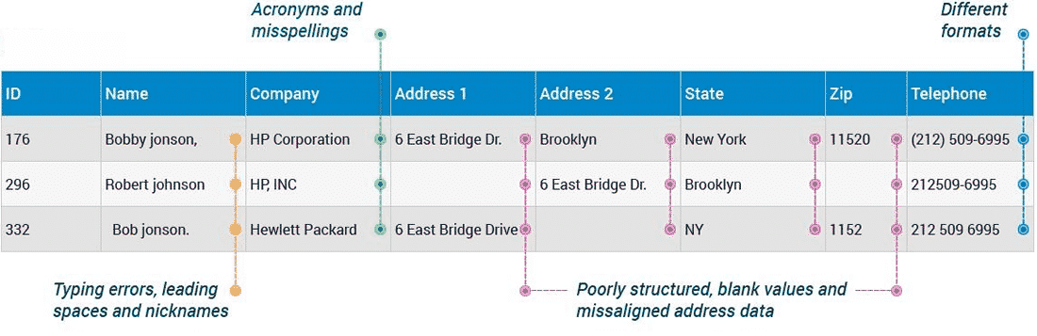
Completeness
A dataset's completeness measures whether all necessary data have been included; if any data are missing, this could produce erroneous results if not fixed before analysis

Slide 19


Uniqueness
The term "uniqueness" relates to whether each record in a given dataset contains unique information; if some records do not have unique information, analysis may produce false findings.

Slide 20
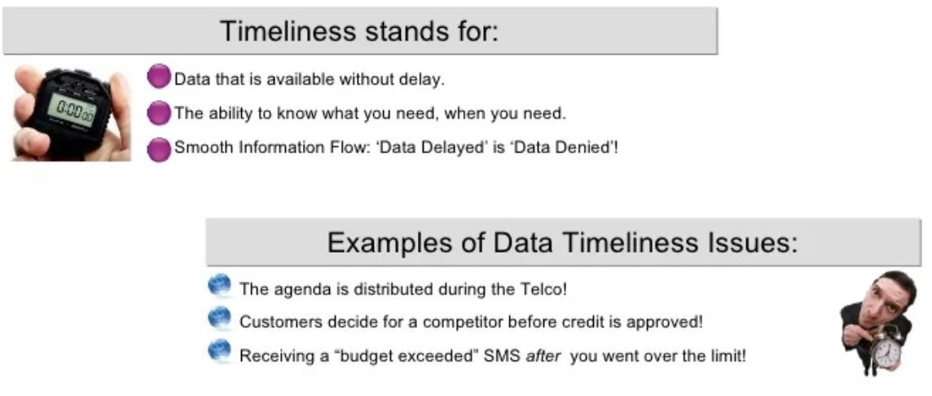
Timeliness
If a dataset's records are current, it is said to be timely; if certain records have out-of-date data, this could also produce inaccurate results if it isn't fixed before analysis.

Slide 21
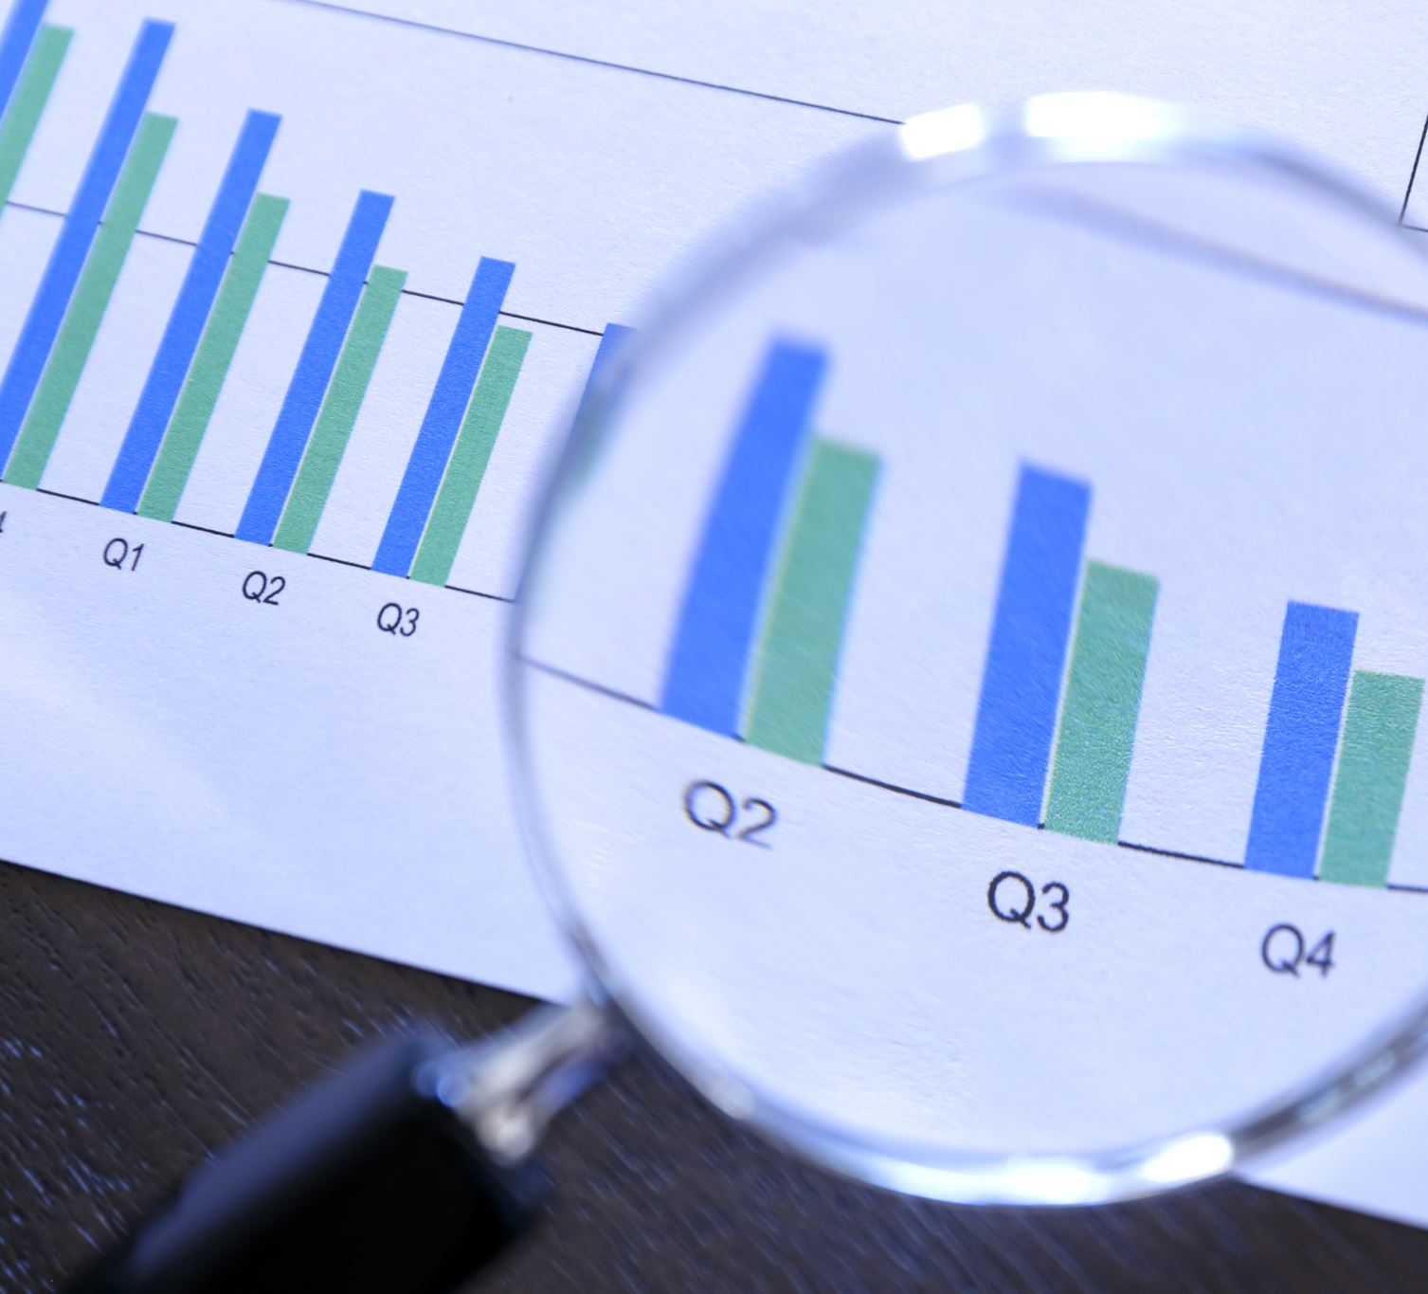
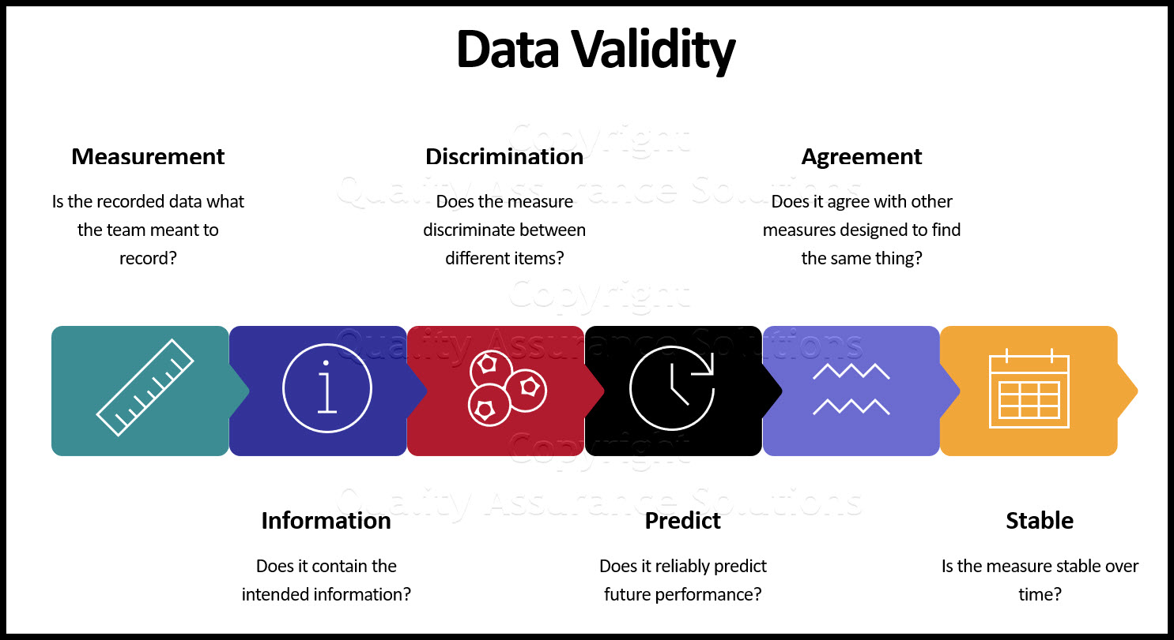
Validity
Validity is the degree to which records in a dataset adhere to predetermined guidelines or criteria; if some records do not, this could also produce inaccurate results if it is not corrected before analysis.

Slide 22
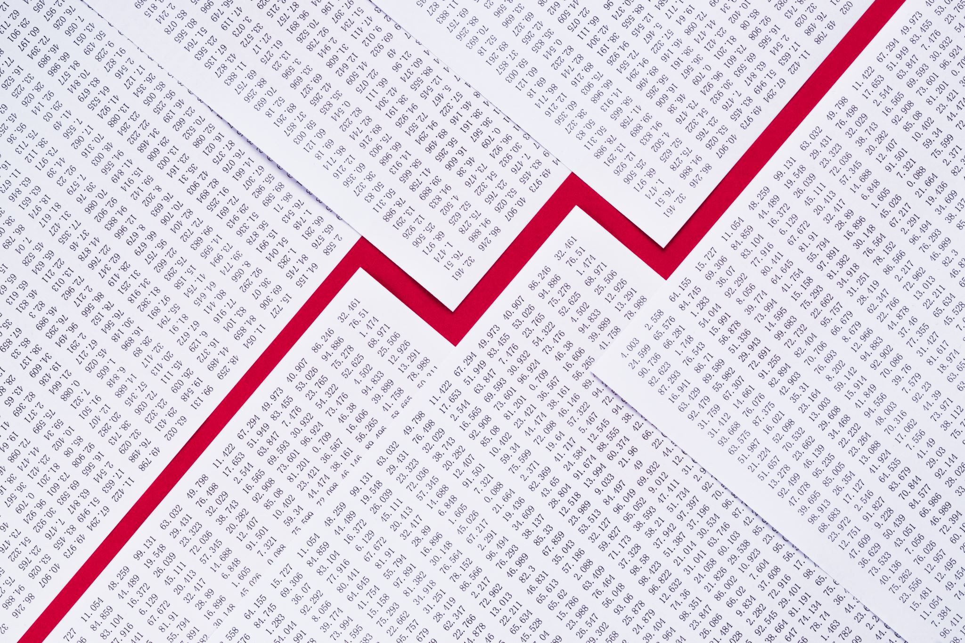
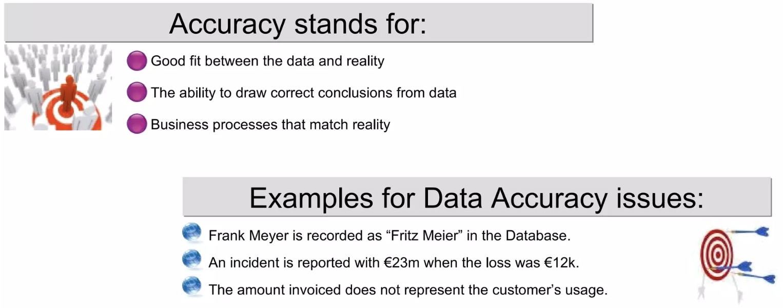
Accuracy
If any records in a dataset have wrong information, this could also result in inaccurate results if it is not rectified before starting the analysis, which is what accuracy refers to.

Slide 23

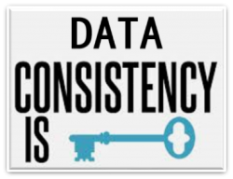
Consistency
Last but not least, consistency relates to whether records inside a given dataset obey consistent rules across multiple datasets; if some rules change across different datasets, this could potentially lead to erroneous results if it is not addressed before starting analysis. Last but not least, consistency relates to whether records inside a given dataset obey consistent rules across multiple datasets; if some rules change across different datasets, this could potentially lead to erroneous results if it is not addressed before starting analysis.

Slide 24

Conclusion
In order to ensure accurate, high-quality, and meaningful results from any subsequent studies, it is crucial to consider data quality when preparing datasets for analysis. Prior to conducting any studies, data profiling can assist detect potential issues with datasets, and taking into account several factors including completeness, uniqueness, timeliness, validity, accuracy, and consistency can help guarantee that datasets are appropriate for usage. Results from any following analysis will be more accurate, high-quality, and valuable if these variables are taken into consideration when creating datasets for analyses.

